Slide 1
Assignment 1: Page Detection
1427936
1329020
1328948
Timon Höbert
Stefan Stappen
Manuel Mayerhofer

Slide 2
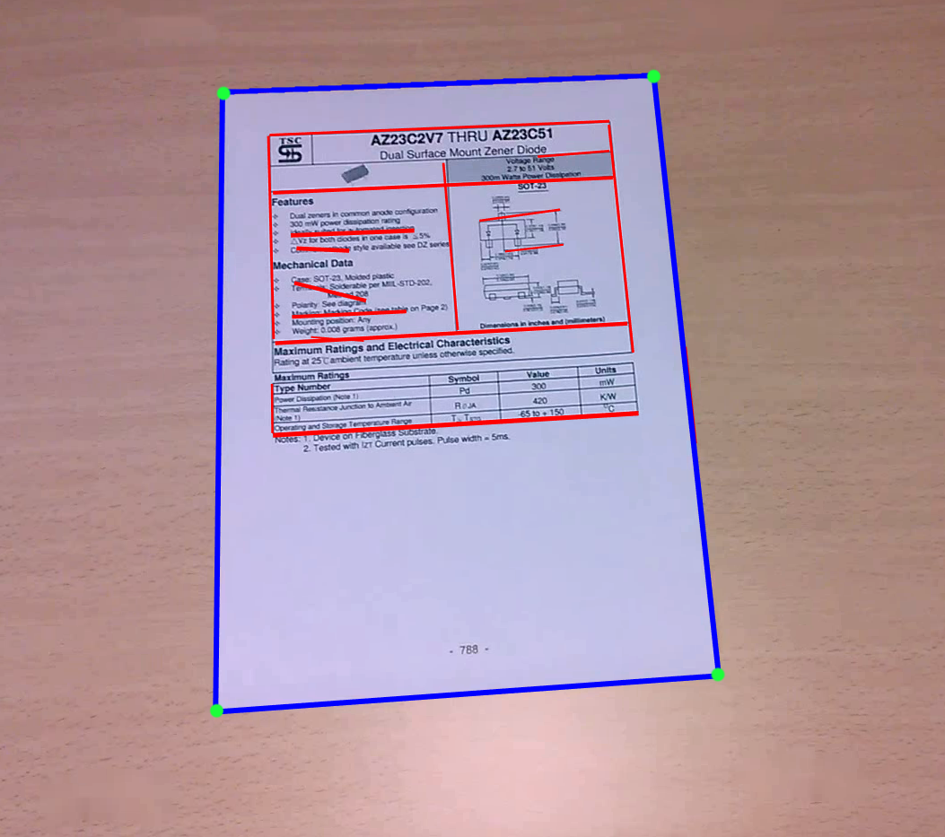
Motivation
Separation background / document
Goal: Quadrilateral coordinates of the document

Slide 3
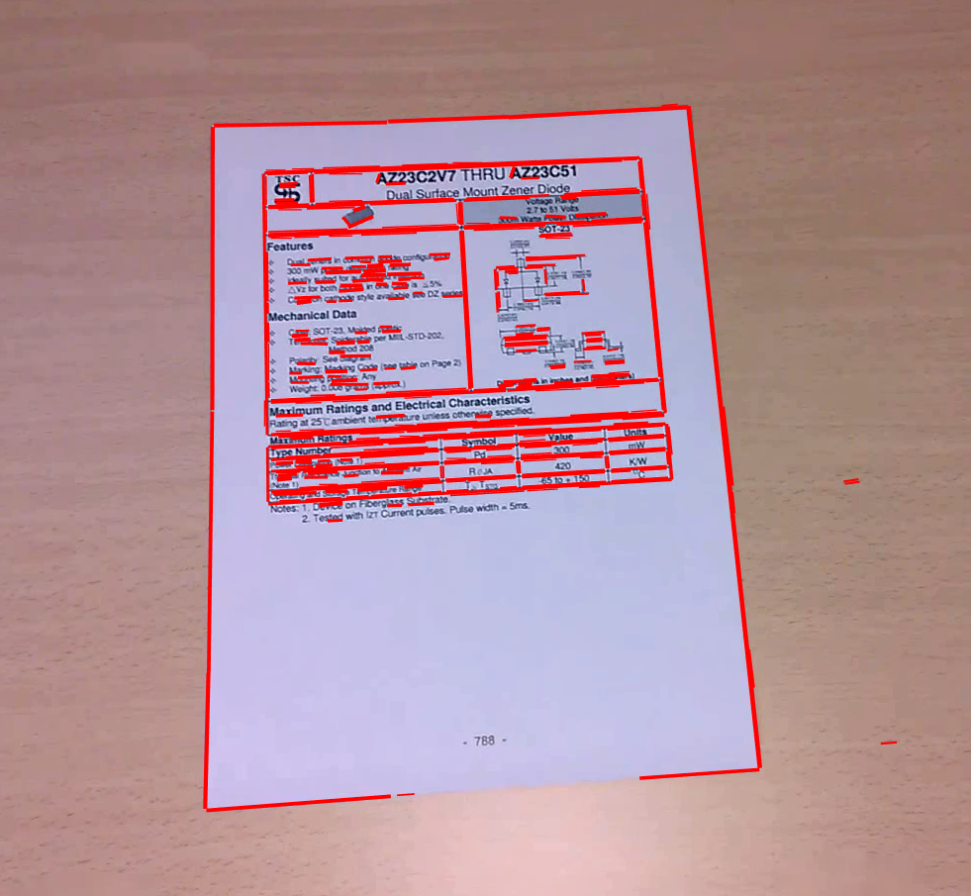
LSD Line Segment Detector
Extract lines with LSD

Slide 4
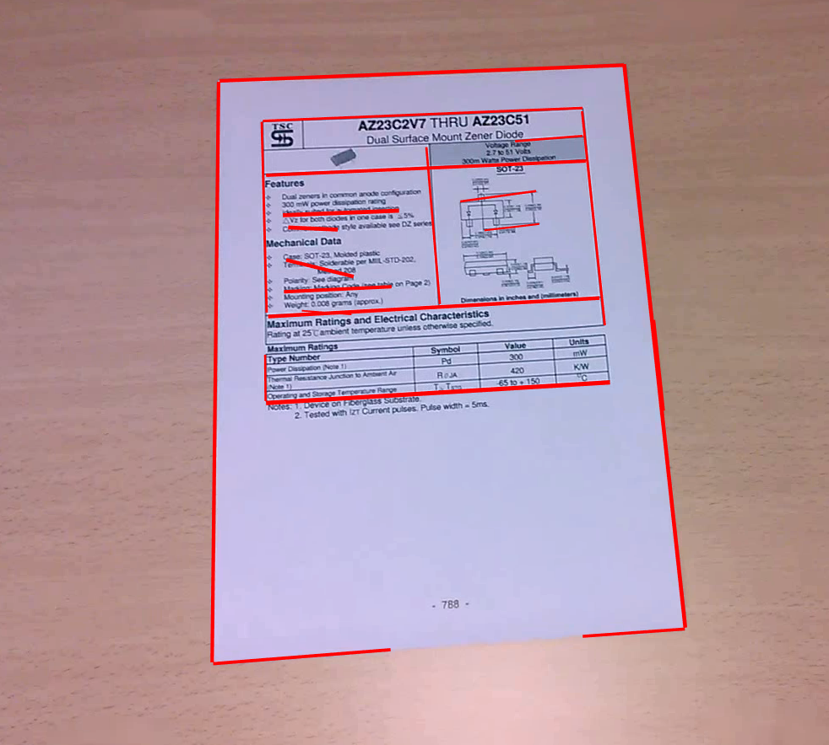
Line selection & grouping
Group: Horizontal / Vertical lines
Merge lines
Minimal length
Remove border lines

Slide 5
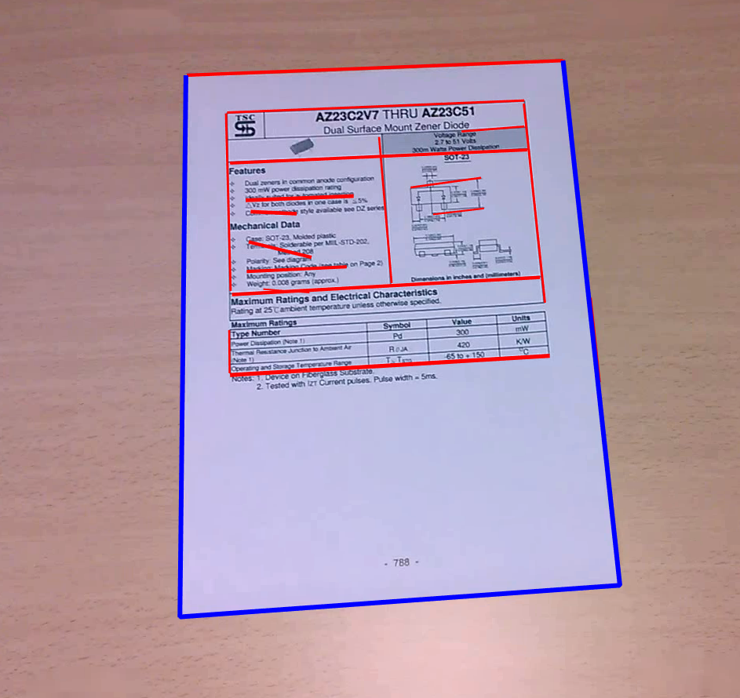
Bounding Box
Input: 2 Vertical 2 Horizontal
3 lines share a point
Lines into each other
Bounding Box Properties
Area
Length h/v lines
Aspect ratio
Inner angles

Slide 6
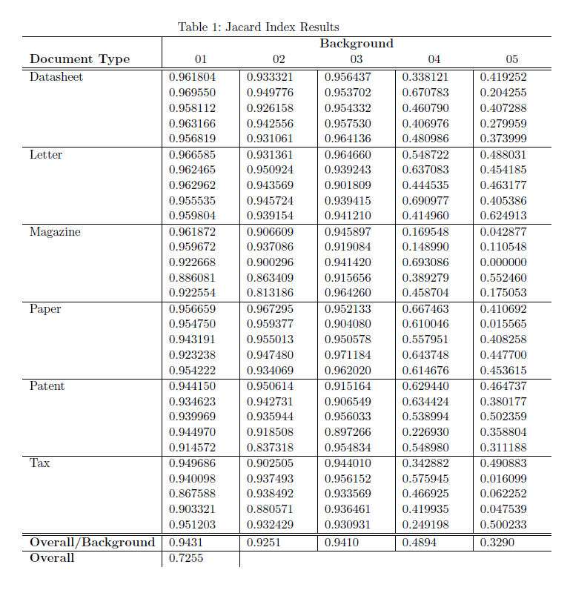
Results

Slide 7
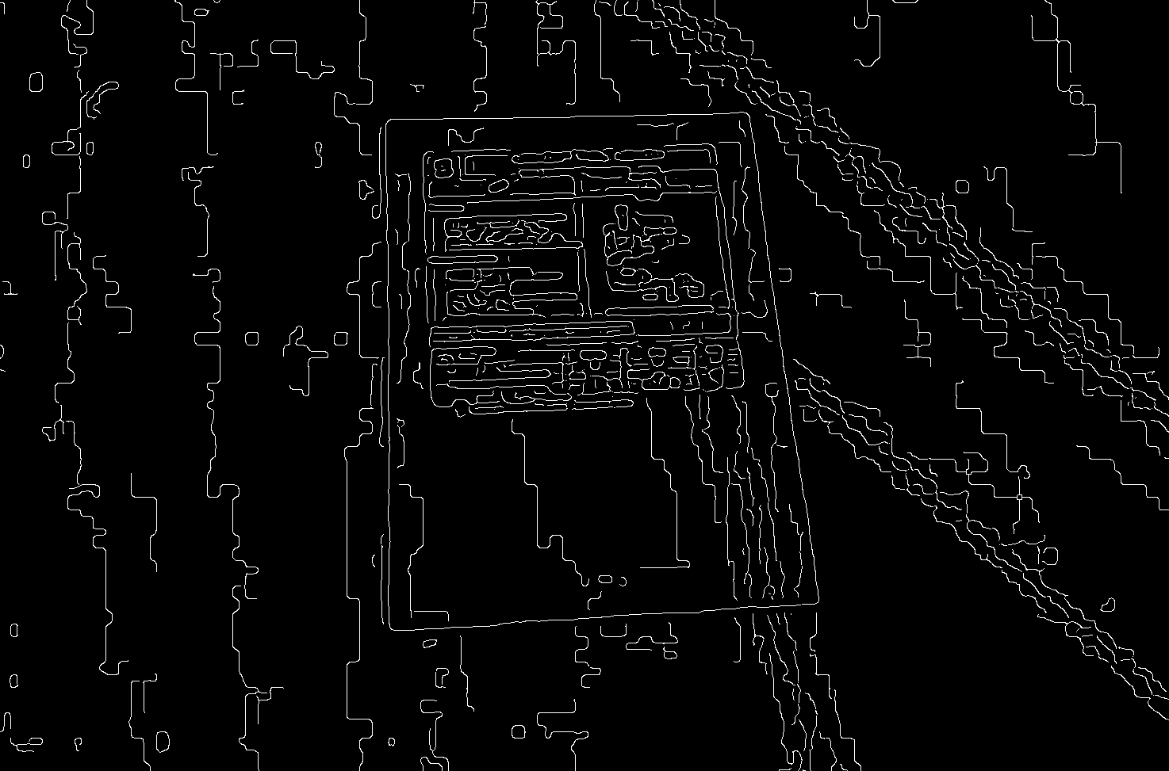
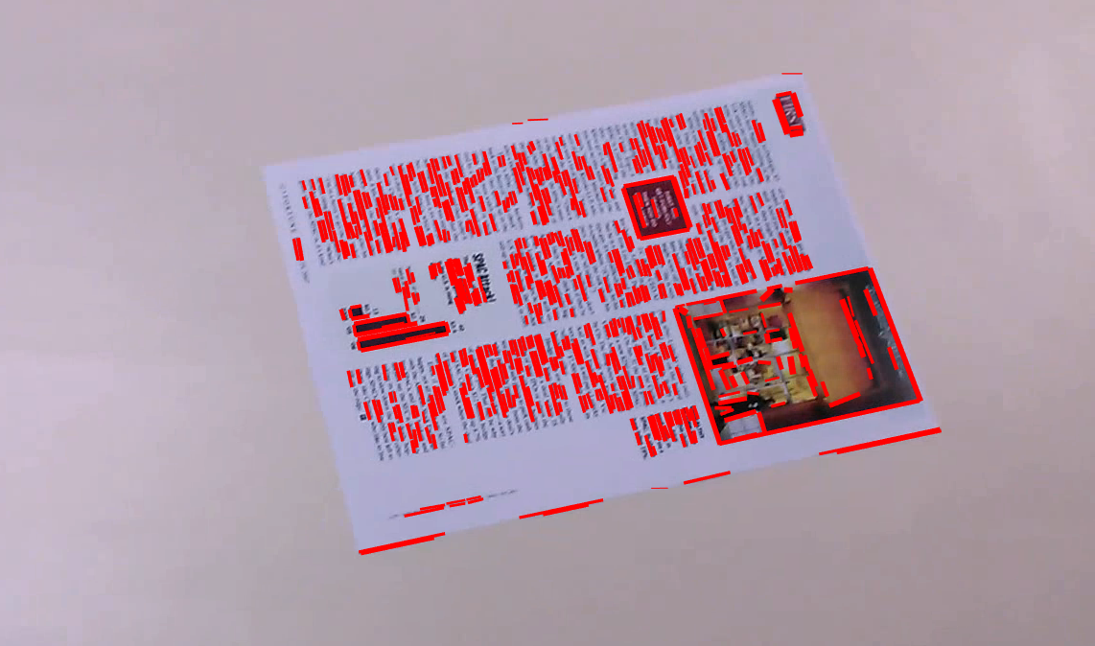
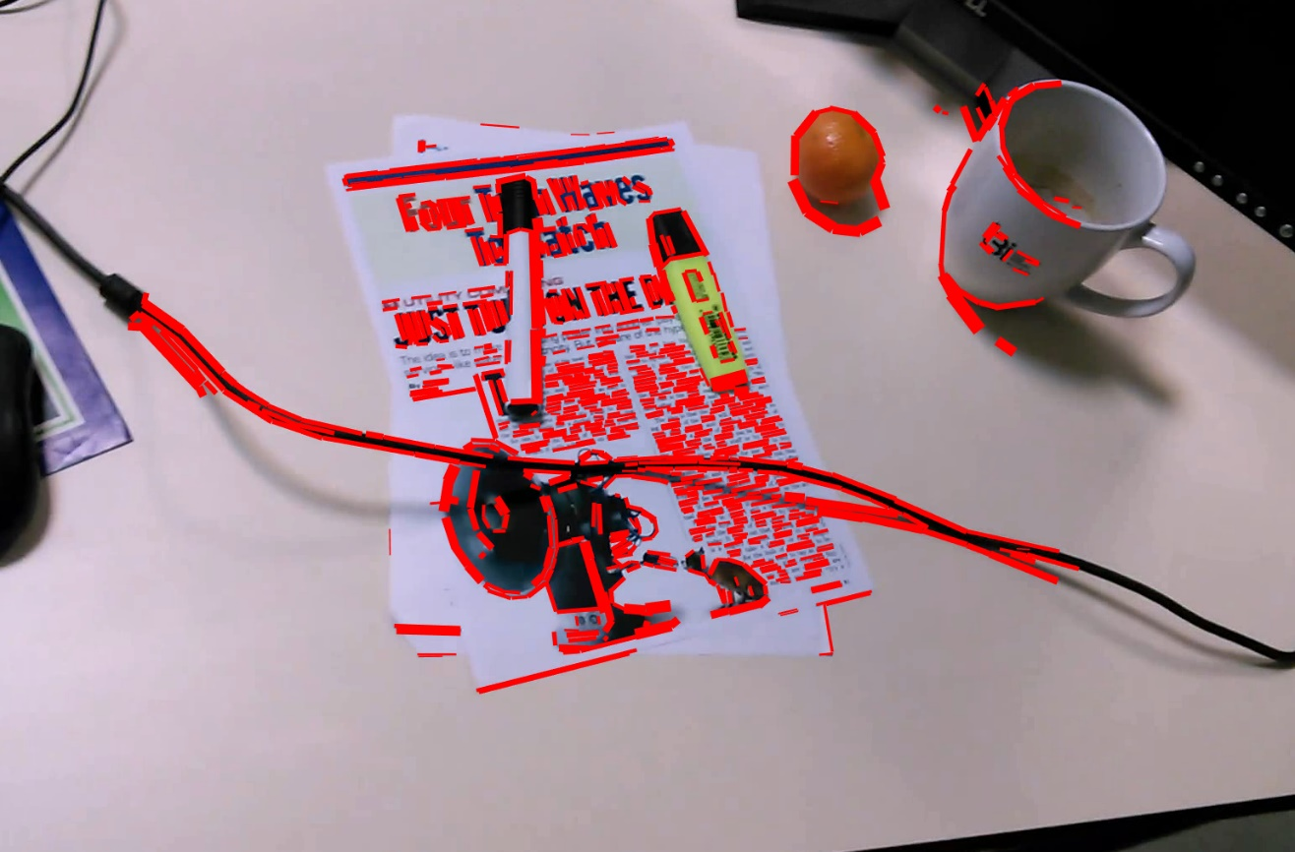
Problems
Dataset 4 & 5

Slide 8
Assignment 2: Optical Character Recognition (OCR)
1427936
1329020
1328948
Timon Höbert
Stefan Stappen
Manuel Mayerhofer

Slide 9
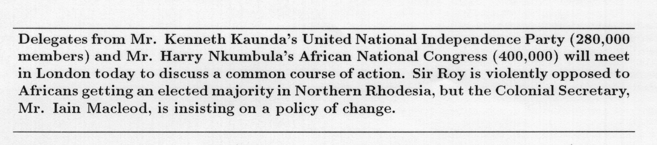
Motivation
Many printed documents
Smartphones with cameras

Slide 10
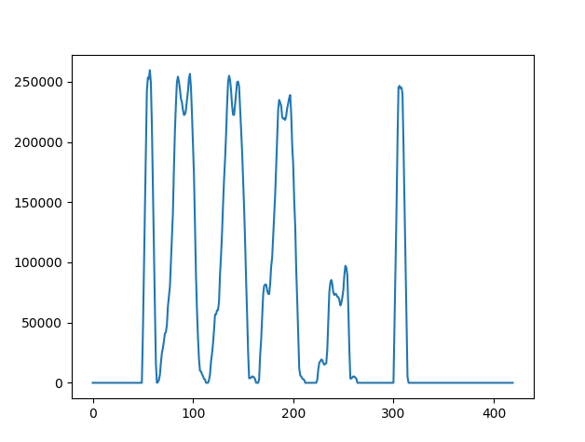
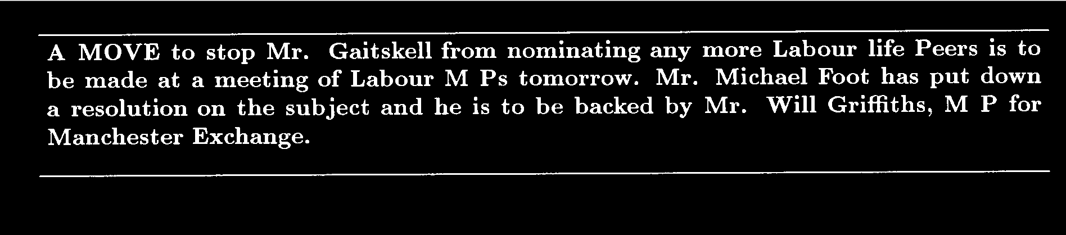
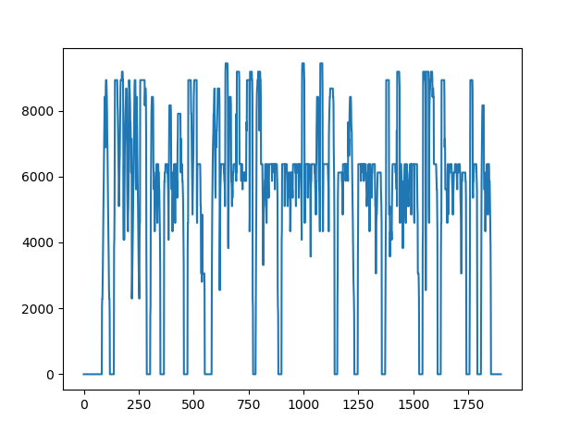


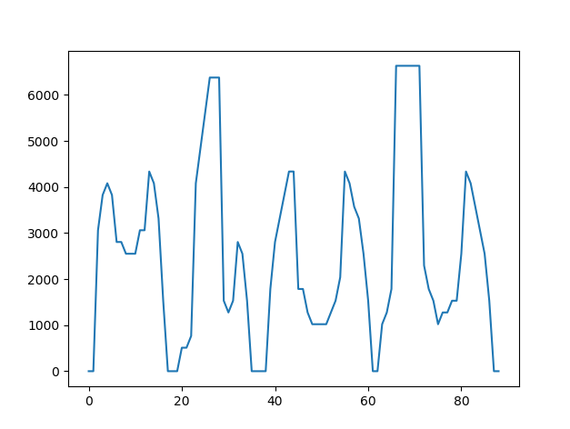



Segmentation
Pre-processing
Gaussian blur
Otsu-threshold
dilate
Projection profiles
Horizontal: Lines
Vertical: Words/Characters
Merged/Splitted Characters

Slide 11
Convolutional Neural Network (CNN)
Tensorflow & Keras
Generation of random Letters in random fonts for training
Currently 16384 for training, 4069 for evaluation (100%)
cropping to content
scaling (28x28 pixels)
Generation of ground truth file (.tsv)
Generation of model.h5 with architecture and weights

Slide 12
CNN Architecture
Layer (type) Output Shape Param # ================================================================= 2D-Convolution (26, 26, 32) 320 _________________________________________________________________ 2D-Convolution (24, 24, 64) 18496 _________________________________________________________________ MaxPooling-2D (12, 12, 64) 0 _________________________________________________________________ Dropout (12, 12, 64) 0 _________________________________________________________________ Flatten (9216) 0 _________________________________________________________________ Dense (128) 1179776 _________________________________________________________________ Dropout (128) 0 _________________________________________________________________ Dense (64) 8256 ================================================================= Total params: 1,206,848 Trainable params: 1,206,848
Notes:
Softmax in the end, otherwise relu

Slide 13
Results & Discussion
Levenshtein edit distance
divided by text-length
Average
Problem 1: segmentation (’fe’)
Problem 2: punctuation marks
avoid scaling (’o’ vs. ‘.’)
generate and train more
Future work: more fonts
a01-011: 61/382=0.16 a06-051: 65/342=0.19 a05-025: 74/412=0.18 a01-007x: 74/371=0.20 a02-098: 49/421=0.12 a02-067: 71/354=0.20 a03-089: 51/117=0.44 a01-049u:108/481=0.22 a06-090: 63/358=0.18 a01-007: 70/371=0.19 a02-106: 84/621=0.14 a03-063: 69/541=0.13 a02-072: 84/396=0.21 a04-023: 55/426=0.13 Average 0.11

Slide 14
Thank you for your attention

